Slide 1
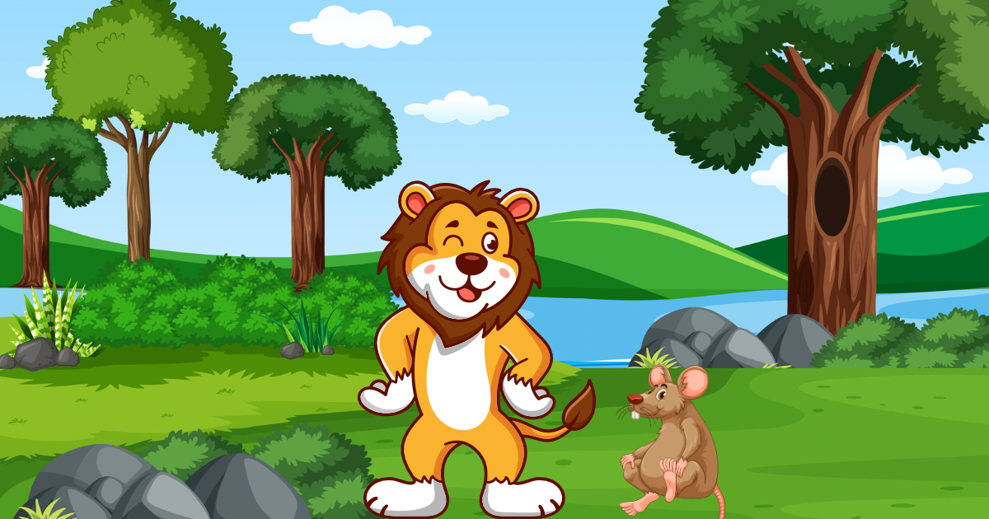
Story : The Lion and the little Mouse
A Story About Kindness and helping Others

Slide 2
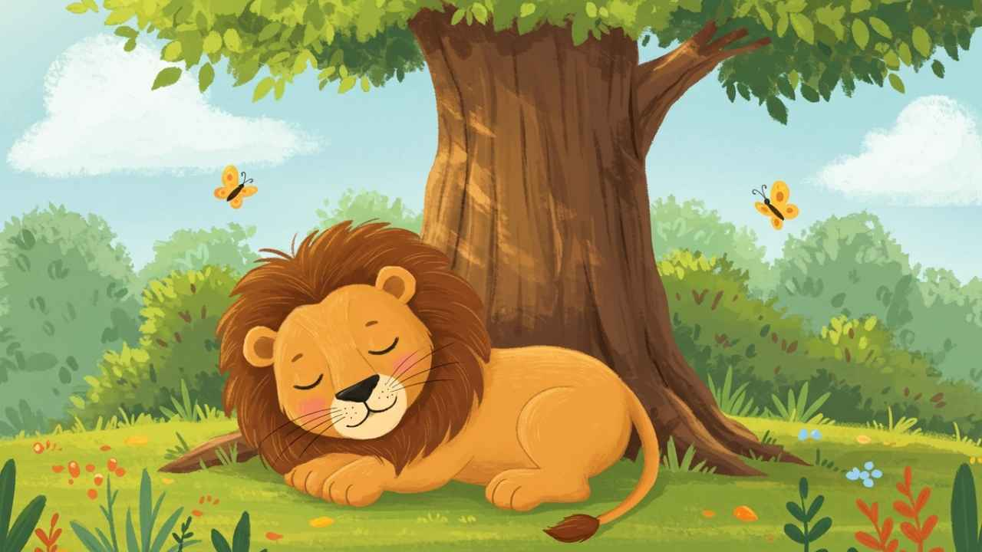
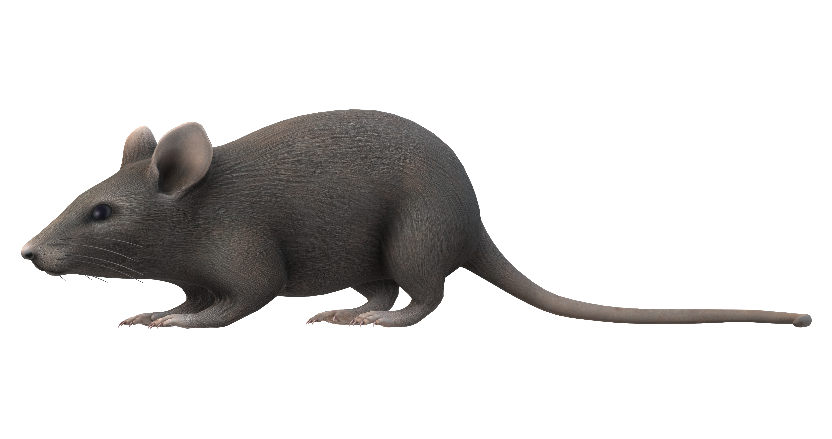
ROARRR! Who dares to disturb my sleep!?
What a nice day to play! Heehee!

Slide 3
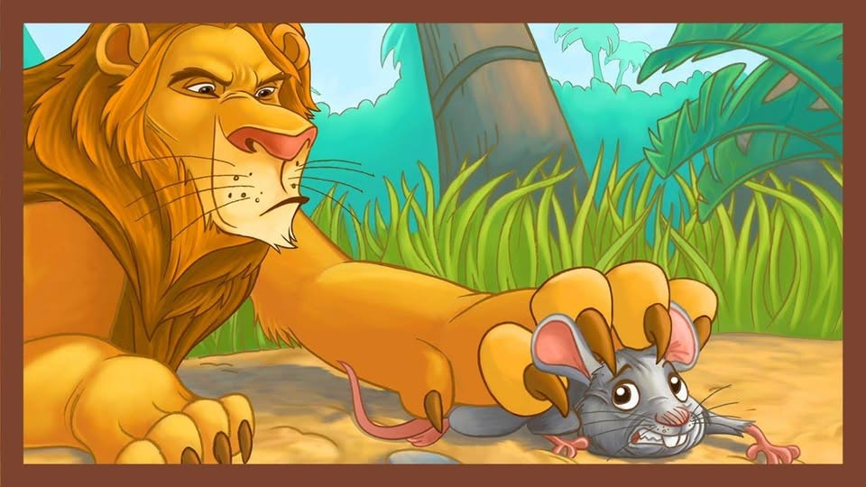
Got you, little one! How dare you wake me up?
Why shouldn’t I eat you right now?
P-please, mighty lion! I didn’t mean to! I’m so sorry!
If you let me go, I promise I’ll help you someday!

Slide 4
Ha! You’re brave, little one. Go on, you’re free.
YOU? Help me? You’re so tiny!
Even small creatures can do great things!
Thank you, kind lion! I’ll never forget this!

Slide 5
Today my mood is good , niklo ab

Slide 6
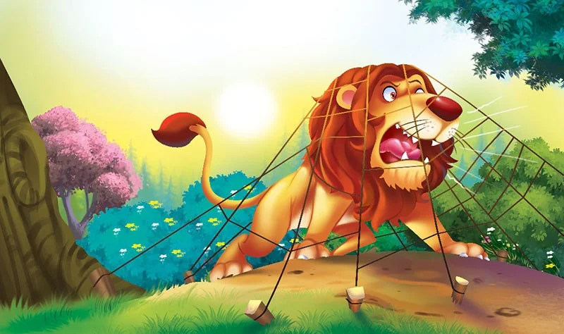
What’s this!? A trap! Oh no!
ROARRR! Somebody help me!

Slide 7
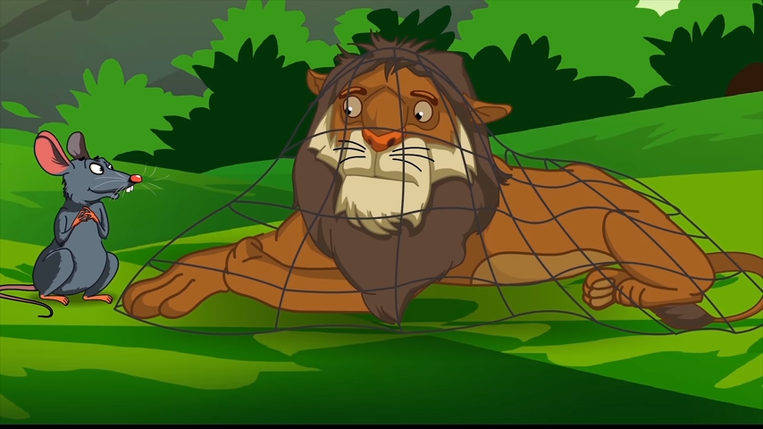
That’s the lion’s voice! He’s in trouble!

Slide 8
You? But what can you do?
Oh no... I should’ve been more careful…
Don’t worry, my friend! I’m here
Just watch!

Slide 9
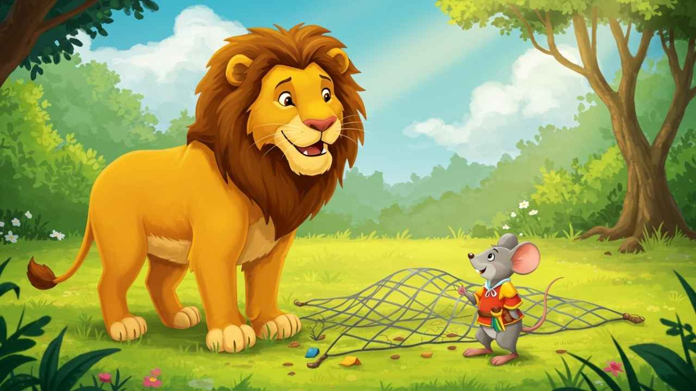
You’re right. Thank you, my brave little friend.
I can’t believe it! You saved my life
I told you — even small ones I told you — even small ones can help big ones!can help big ones!

Slide 10
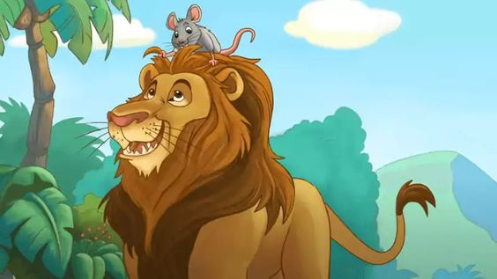
And so, the mighty lion and the tiny mouse became best friends.
Remember Kids — kindness is never wasted.

